Slide 1

Simulations of Organic Semiconductors – Part I: force-field parameterization
Kun-Han Lin
Notes:
Hello everyone, today I’d like to share some of my results on OLED emitters. I will explain these acronyms appearing in my title in the following slides.

Slide 2

Our goal
Bulk properties → simulated morphology → FF parameters needed!
Very often, FF parameters of ”practical” compounds are incomplete.
Derive missing parameters from QM computations.
Goal: build a .top (topology) and .itp (FF parameters) file for 1CzTrz.
1CzTrz
Notes:
First, I’d like to briefly introduce myself. I’m Kun-Han Lin, I got my PhD at EPFL Switzerland in last September and my advisor was Clemence Corminboeuf.
And I joined Denis’group as a postdoc in last October. My research interest lies in multi-scale simulations and organic semiconductors, especially the charge and energy transport phenomenon in these materials. My main project is to find stable and blue TADF emitters and I also involve in several side projects related to organic semiconductors.

Slide 3
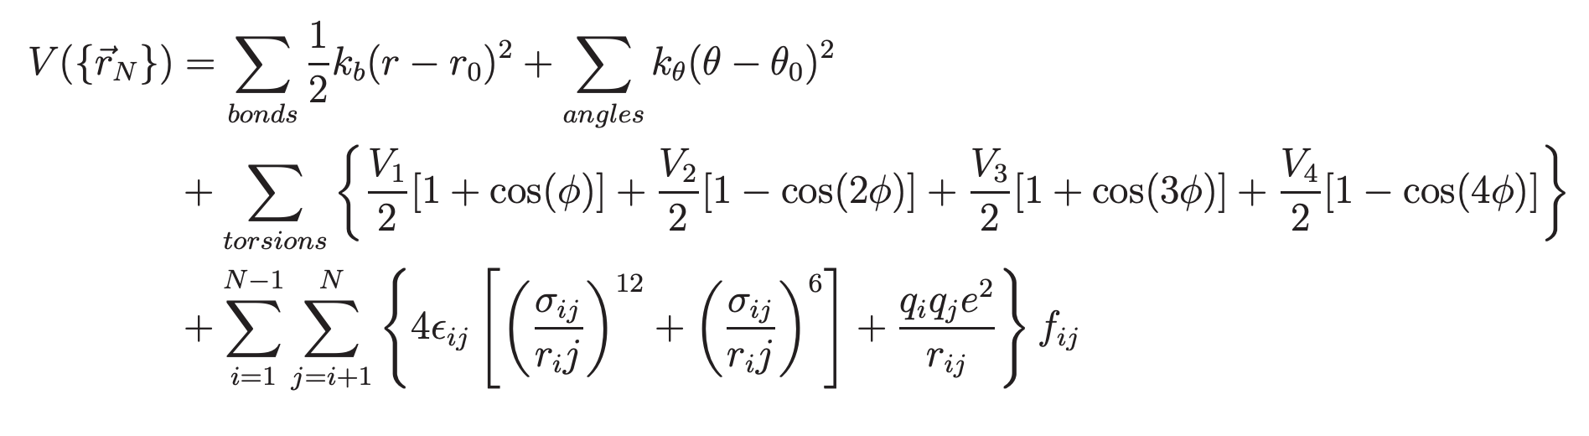
OPLS forcefield
Bonded parameters
Non-bonded parameters
Bond and angle → taken from OPLS database (LigParGen sever)
Dihedral → QM dihedral scanning (constrained optimization)
Atomic charge → reproduce QM electrostatic potential (MK, CHelpG and DDEC)
LJ → DDEC + Tkatchenko-Scherffler method
Notes:
First, I’d like to briefly introduce myself. I’m Kun-Han Lin, I got my PhD at EPFL Switzerland in last September and my advisor was Clemence Corminboeuf.
And I joined Denis’group as a postdoc in last October. My research interest lies in multi-scale simulations and organic semiconductors, especially the charge and energy transport phenomenon in these materials. My main project is to find stable and blue TADF emitters and I also involve in several side projects related to organic semiconductors.

Slide 4
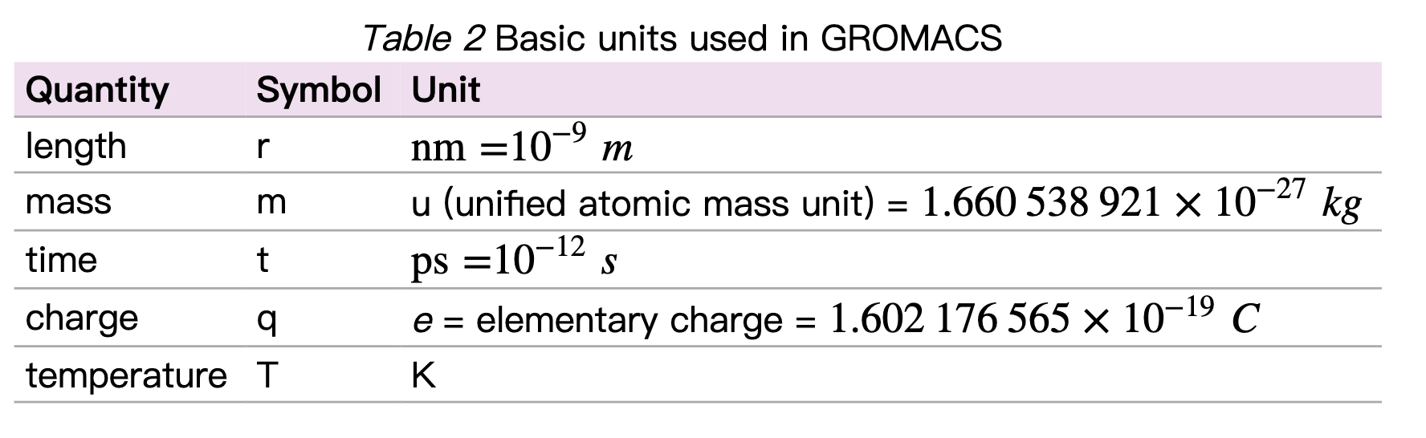
Unit convention in GROMACS
The units conventions are listed in the tables; can not be defined by users (?).
Notes:
First, I’d like to briefly introduce myself. I’m Kun-Han Lin, I got my PhD at EPFL Switzerland in last September and my advisor was Clemence Corminboeuf.
And I joined Denis’group as a postdoc in last October. My research interest lies in multi-scale simulations and organic semiconductors, especially the charge and energy transport phenomenon in these materials. My main project is to find stable and blue TADF emitters and I also involve in several side projects related to organic semiconductors.

Slide 5
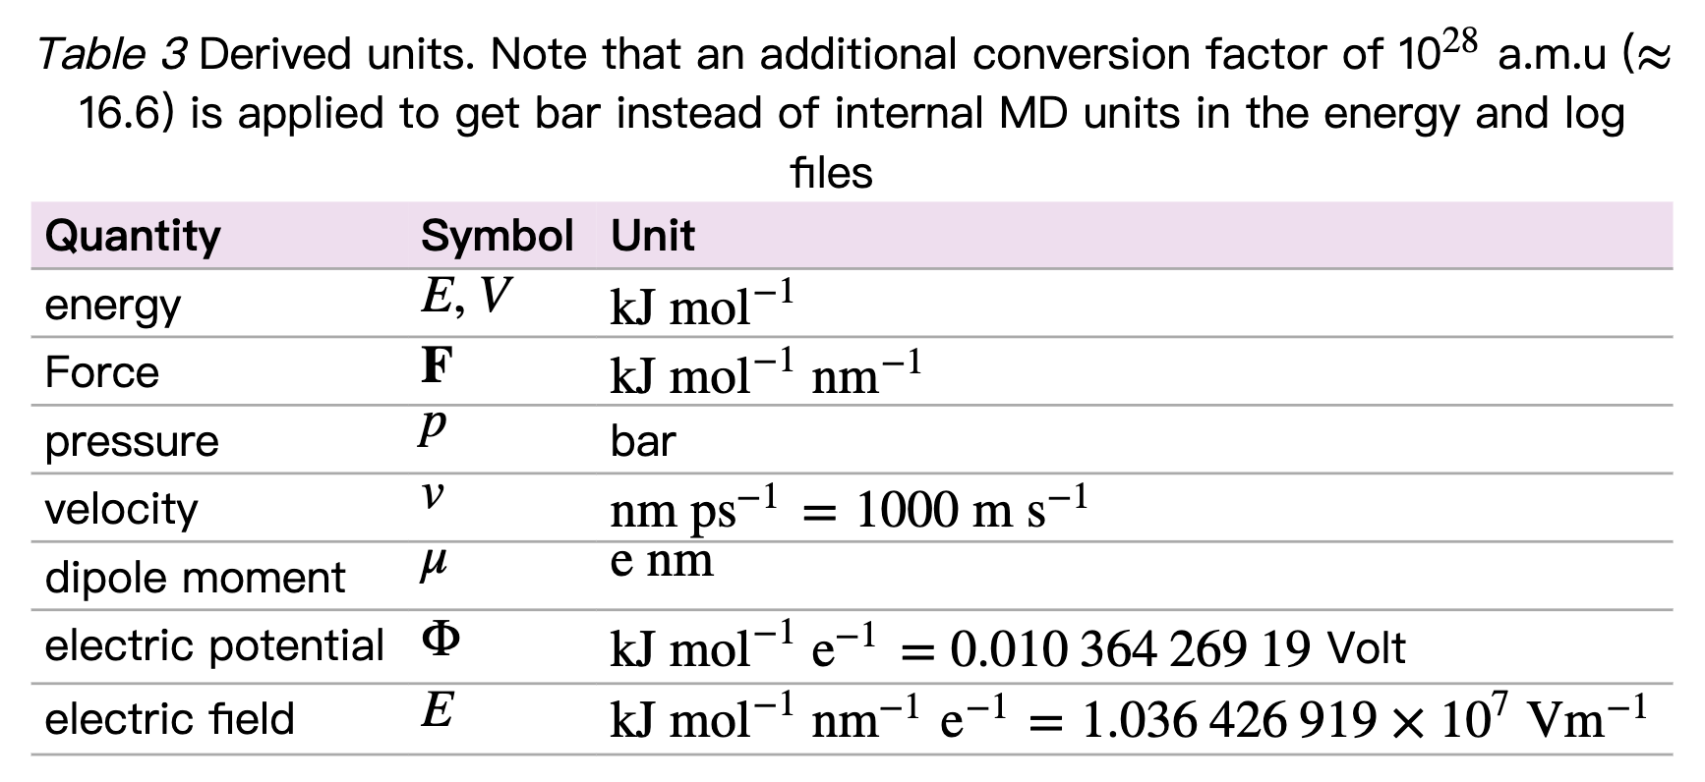
Unit convention in GROMACS
Notes:
First, I’d like to briefly introduce myself. I’m Kun-Han Lin, I got my PhD at EPFL Switzerland in last September and my advisor was Clemence Corminboeuf.
And I joined Denis’group as a postdoc in last October. My research interest lies in multi-scale simulations and organic semiconductors, especially the charge and energy transport phenomenon in these materials. My main project is to find stable and blue TADF emitters and I also involve in several side projects related to organic semiconductors.

Slide 6
What is a .top file in GROMACS?
It is a topology file, containing the information of atomic charge, pair, bond, angle, dihedrals,…
; Include forcefield parameters
#include "./mCP-DDEC.ff/forcefield.itp"
[ moleculetype ]
; Name nrexcl
Other 3
[ atoms ]
; nr type resnr residue atom cgnr charge mass typeB chargeB massB
; residue 1 LCZ rtp LCZ q -0.1
1 N 1 LCZ N1 1 -0.158923 14.0067
2 CN 1 LCZ CNc 1 0.150638 12.011
Exclude neighbors no further than
3 bonds away for non-bonded interactions.
Notes:
First, I’d like to briefly introduce myself. I’m Kun-Han Lin, I got my PhD at EPFL Switzerland in last September and my advisor was Clemence Corminboeuf.
And I joined Denis’group as a postdoc in last October. My research interest lies in multi-scale simulations and organic semiconductors, especially the charge and energy transport phenomenon in these materials. My main project is to find stable and blue TADF emitters and I also involve in several side projects related to organic semiconductors.

Slide 7
What is a .top file in GROMACS?
[ bonds ]
; ai aj funct c0 c1 c2 c3
1 2 1
…
[ pairs ]
; ai aj funct c0 c1 c2 c3
1 7 1
…
[ exclusions ]
; i excluded from i
14 28 31
…
[ angles ]
; ai aj ak funct c0 c1 c2 c3
2 1 5 1
…
[ dihedrals ]
; ai aj ak al funct c0 c1 c2 c3 c4 c5
2 1 26 27 3
[ system ]
; Name
mCP-DDEC
[ molecules ]
; Compound #mols
Other 1
Generate the .top file using pdb2gmx → we need .pdb, .atp and .rtp files!
Notes:
First, I’d like to briefly introduce myself. I’m Kun-Han Lin, I got my PhD at EPFL Switzerland in last September and my advisor was Clemence Corminboeuf.
And I joined Denis’group as a postdoc in last October. My research interest lies in multi-scale simulations and organic semiconductors, especially the charge and energy transport phenomenon in these materials. My main project is to find stable and blue TADF emitters and I also involve in several side projects related to organic semiconductors.

Slide 8
Building the .atp file
To build .top file, we need .atp file.
It defines all atom types in the molecule
C 12.01100 ; Carbon in benzene
H 1.00800 ; any Hydrogen
N 14.00670 ; Nitrogen in carbazole
CN 12.01100 ; Carbon next to N in pyrrole ring
CP 12.01100 ; Other carbon in pyrrole ring
CCC 12.01100 ; bonding carbon btw two benzenes
CZ 12.01100 ; bonding carbon to carbazole
1CzTrz
Notes:
First, I’d like to briefly introduce myself. I’m Kun-Han Lin, I got my PhD at EPFL Switzerland in last September and my advisor was Clemence Corminboeuf.
And I joined Denis’group as a postdoc in last October. My research interest lies in multi-scale simulations and organic semiconductors, especially the charge and energy transport phenomenon in these materials. My main project is to find stable and blue TADF emitters and I also involve in several side projects related to organic semiconductors.

Slide 9
Building .rtp files
BFL.rtp
BFR.rtp
To build .top file, we need .rtp files.
The .rtp files stand for residue topology.
Divide a molecule into residues. How?
Rigid components connected by rotatable dihedrals. Not unique.
Define bond types, atoms, bonds, dihedrals and exclusions in the residue.
TRZ.rtp
BEN.rtp
CBZ.rtp
1CzTrz
TBU.rtp
Notes:
First, I’d like to briefly introduce myself. I’m Kun-Han Lin, I got my PhD at EPFL Switzerland in last September and my advisor was Clemence Corminboeuf.
And I joined Denis’group as a postdoc in last October. My research interest lies in multi-scale simulations and organic semiconductors, especially the charge and energy transport phenomenon in these materials. My main project is to find stable and blue TADF emitters and I also involve in several side projects related to organic semiconductors.

Slide 10
Example of MET.rtp file
Ryckaert-Bellemans
[ bondedtypes ]
; bonds angles dihedrals impropers
1 1 3 2
[ ME1 ]
[ atoms ]
CM1 CM -0.3856899551 5
HM1 HM 0.1260820449 5
HM2 HM 0.1284075449 5
HM3 HM 0.1342175449 5
[ bonds ]
CM1 HM1
CM1 HM2
CM1 HM3
harmonic
harmonic
harmonic
HM1
residue name
define atom
CM1
HM2
atom name
atomic charge
charge group
atom type
HM3
define bond
Notes:
First, I’d like to briefly introduce myself. I’m Kun-Han Lin, I got my PhD at EPFL Switzerland in last September and my advisor was Clemence Corminboeuf.
And I joined Denis’group as a postdoc in last October. My research interest lies in multi-scale simulations and organic semiconductors, especially the charge and energy transport phenomenon in these materials. My main project is to find stable and blue TADF emitters and I also involve in several side projects related to organic semiconductors.

Slide 11
Building a .pdb file
BFL.rtp
BFR.rtp
To build .top file, we need a .pdb file.
Atomic index, symbol, name, coordinate, residue name and residue ID.
Atoms belong to the same residue should be grouped together!
Atomic order in .pdb and .rtp files should match.
TRZ.rtp
BEN.rtp
CBZ.rtp
1CzTrz
TBU.rtp
Notes:
First, I’d like to briefly introduce myself. I’m Kun-Han Lin, I got my PhD at EPFL Switzerland in last September and my advisor was Clemence Corminboeuf.
And I joined Denis’group as a postdoc in last October. My research interest lies in multi-scale simulations and organic semiconductors, especially the charge and energy transport phenomenon in these materials. My main project is to find stable and blue TADF emitters and I also involve in several side projects related to organic semiconductors.

Slide 12
Example of 1CzTrz.pdb file
TITLE 1CzTrz-DDEC
MODEL 1
HETATM 1 CZ1 TRZ 1 -0.277 0.537 -0.005 1.00 0.00 C
HETATM 2 CZ2 TRZ 1 1.670 1.671 0.136 1.00 0.00 C
HETATM 3 CZ3 TRZ 1 -0.270 2.790 -0.140 1.00 0.00 C
HETATM 4 NZ1 TRZ 1 1.055 2.845 -0.001 1.00 0.00 N
HETATM 5 NZ2 TRZ 1 1.047 0.492 0.140 1.00 0.00 N
HETATM 6 NZ3 TRZ 1 -0.978 1.661 -0.148 1.00 0.00 N
HETATM 7 CZa BFL 2 3.142 1.675 0.293 1.00 0.00 C
HETATM 8 C2 BFL 2 3.848 2.879 0.291 1.00 0.00 C
HETATM 9 C3 BFL 2 3.837 0.474 0.446 1.00 0.00 C
HETATM 10 C4 BFL 2 5.226 2.889 0.438 1.00 0.00 C
atom
index
residue
name
x
y
z
element
symbol
atom
name
residue
index
Notes:
First, I’d like to briefly introduce myself. I’m Kun-Han Lin, I got my PhD at EPFL Switzerland in last September and my advisor was Clemence Corminboeuf.
And I joined Denis’group as a postdoc in last October. My research interest lies in multi-scale simulations and organic semiconductors, especially the charge and energy transport phenomenon in these materials. My main project is to find stable and blue TADF emitters and I also involve in several side projects related to organic semiconductors.

Slide 13
How to construct a pdb file of initial geometry?
GAUSSVIEW
Avogadro
Use insert fragment/residue to keep atoms grouped properly
SMILE/Avogadro; SMILE/Openbabel
Preoptimize with forcefield or semi-empirical method
Notes:
First, I’d like to briefly introduce myself. I’m Kun-Han Lin, I got my PhD at EPFL Switzerland in last September and my advisor was Clemence Corminboeuf.
And I joined Denis’group as a postdoc in last October. My research interest lies in multi-scale simulations and organic semiconductors, especially the charge and energy transport phenomenon in these materials. My main project is to find stable and blue TADF emitters and I also involve in several side projects related to organic semiconductors.

Slide 14
Geometry optimization using DFT
GAUSSIAN16, ORCA, Turbomole, Qchem….
What DFT functional? LDA, GGA, meta-GGA, global hybrid, range-separated hybrid, double hybrid…
What basis set? Gaussian-type or Slater-type; Pople basis set, Dunning basis set, Karlsruhe basis set…
Empirical dispersion?
Notes:
First, I’d like to briefly introduce myself. I’m Kun-Han Lin, I got my PhD at EPFL Switzerland in last September and my advisor was Clemence Corminboeuf.
And I joined Denis’group as a postdoc in last October. My research interest lies in multi-scale simulations and organic semiconductors, especially the charge and energy transport phenomenon in these materials. My main project is to find stable and blue TADF emitters and I also involve in several side projects related to organic semiconductors.

Slide 15
Input of GAUSSIAN16
Request memory
%mem=60000MB
#P opt wb97xd/6-311g(d,p) nosymm density=current output=wfx pop=NO
Title Card Required
0 1
N -0.410000 2.464000 0.386000
C -0.224000 3.784000 0.933000
C -0.530000 4.737000 -0.068000
…
Job and input
Title
Charge and multiplicity
Element symbol and coordinates
Should be ended with a blank line (stupid but very important)
Notes:
First, I’d like to briefly introduce myself. I’m Kun-Han Lin, I got my PhD at EPFL Switzerland in last September and my advisor was Clemence Corminboeuf.
And I joined Denis’group as a postdoc in last October. My research interest lies in multi-scale simulations and organic semiconductors, especially the charge and energy transport phenomenon in these materials. My main project is to find stable and blue TADF emitters and I also involve in several side projects related to organic semiconductors.

Slide 16
Hands-on: construct a pdb file of optimized 1CzTrz
BFL.rtp
BFR.rtp
Use Avogadro to build initial geometry
Name and index each atom and residue
Group (reorder) atoms belonging to the same residue
Construct a GAUSSIAN16 input file and perform geometry optimization using ωB97XD/6-311G(d,p)
Update the .pdb file with new geometry
TRZ.rtp
BEN.rtp
CBZ.rtp
1CzTrz
TBU.rtp
Notes:
First, I’d like to briefly introduce myself. I’m Kun-Han Lin, I got my PhD at EPFL Switzerland in last September and my advisor was Clemence Corminboeuf.
And I joined Denis’group as a postdoc in last October. My research interest lies in multi-scale simulations and organic semiconductors, especially the charge and energy transport phenomenon in these materials. My main project is to find stable and blue TADF emitters and I also involve in several side projects related to organic semiconductors.

Slide 17
Hands-on: construct rtp files for all residues of 1CzTrz
BFL.rtp
BFR.rtp
Open two screens (strongly recommended!)
Use Molden to visualize
Check the files in EXAMPLE folder if get stuck /data/bee14/link/work/4_Naomi/EXAMPLE
Pay attention to the connecting atoms (+/-)
The order of atoms in .pdb and .rtp should match
Atomic charge (we’ll come back to it later)
TRZ.rtp
BEN.rtp
CBZ.rtp
1CzTrz
TBU.rtp
Notes:
First, I’d like to briefly introduce myself. I’m Kun-Han Lin, I got my PhD at EPFL Switzerland in last September and my advisor was Clemence Corminboeuf.
And I joined Denis’group as a postdoc in last October. My research interest lies in multi-scale simulations and organic semiconductors, especially the charge and energy transport phenomenon in these materials. My main project is to find stable and blue TADF emitters and I also involve in several side projects related to organic semiconductors.

Slide 18
Hands-on: create folders for 2-phenylpyrimidine (PPD)
Create folder for later using dihedral.py
PMD.rtp
LIBRARY/
PPD/
FORCEFIELD/
QM_GAS_PHASE
SCANS
STRUCTURE
PPD.ff
Contain .rtp and .itp
Gaussian computations
Dihedral scanning
BEN.rtp
Contain .pdb files
Notes:
First, I’d like to briefly introduce myself. I’m Kun-Han Lin, I got my PhD at EPFL Switzerland in last September and my advisor was Clemence Corminboeuf.
And I joined Denis’group as a postdoc in last October. My research interest lies in multi-scale simulations and organic semiconductors, especially the charge and energy transport phenomenon in these materials. My main project is to find stable and blue TADF emitters and I also involve in several side projects related to organic semiconductors.

Slide 19
Hands-on: construct a pdb file of 2-phenylpyrimidine
Use Avogadro to build initial geometry
Name and index each atom and residue
Group (reorder) atoms belonging to the same residue
Construct a GAUSSIAN16 input file and perform geometry optimization using ωB97XD/6-311G(d,p)
Update the .pdb file with new geometry
PMD.rtp
BEN.rtp
Notes:
First, I’d like to briefly introduce myself. I’m Kun-Han Lin, I got my PhD at EPFL Switzerland in last September and my advisor was Clemence Corminboeuf.
And I joined Denis’group as a postdoc in last October. My research interest lies in multi-scale simulations and organic semiconductors, especially the charge and energy transport phenomenon in these materials. My main project is to find stable and blue TADF emitters and I also involve in several side projects related to organic semiconductors.

Slide 20
Hands-on: construct a pdb file of 2-phenylpyrimidine
Use Avogadro to build initial geometry
Name and index each atom and residue
Group (reorder) atoms belonging to the same residue
Construct a GAUSSIAN16 input file and perform geometry optimization using ωB97XD/6-311G(d,p)
Update the .pdb file with new geometry
PMD.rtp
CN
CN
CNZ
CZ
BEN.rtp
N: N in pyrimidine
C: all other aromatic carbon
H: H attached to aromatic carbon
Notes:
First, I’d like to briefly introduce myself. I’m Kun-Han Lin, I got my PhD at EPFL Switzerland in last September and my advisor was Clemence Corminboeuf.
And I joined Denis’group as a postdoc in last October. My research interest lies in multi-scale simulations and organic semiconductors, especially the charge and energy transport phenomenon in these materials. My main project is to find stable and blue TADF emitters and I also involve in several side projects related to organic semiconductors.

Slide 21
Hands-on: construct rtp files of 2-phenylpyrimidine
Open two screens (strongly recommended!)
Use Molden to visualize
Check the files in EXAMPLE folder if get stuck /data/bee14/link/work/4_Naomi/EXAMPLE
Pay attention to the connecting atoms (+/-)
The order of atoms in .pdb and .rtp should match
Atomic charge (we’ll come back to it later)
PMD.rtp
BEN.rtp
Notes:
First, I’d like to briefly introduce myself. I’m Kun-Han Lin, I got my PhD at EPFL Switzerland in last September and my advisor was Clemence Corminboeuf.
And I joined Denis’group as a postdoc in last October. My research interest lies in multi-scale simulations and organic semiconductors, especially the charge and energy transport phenomenon in these materials. My main project is to find stable and blue TADF emitters and I also involve in several side projects related to organic semiconductors.

Slide 22
Hands-on: how to define bonds
Define all covalent bonds; for example in BEN.rtp:
PMD.rtp
[ bonds ]
C1 C2
C2 C3
C3 C4
C4 C5
C5 CZ
CZ C1
C1 H1
C2 H2
C3 H3
C4 H4
C5 H5
connection between CZ and CNZ?
CNZ
CZ
C5
C1
C4
C2
C3
BEN.rtp
Notes:
First, I’d like to briefly introduce myself. I’m Kun-Han Lin, I got my PhD at EPFL Switzerland in last September and my advisor was Clemence Corminboeuf.
And I joined Denis’group as a postdoc in last October. My research interest lies in multi-scale simulations and organic semiconductors, especially the charge and energy transport phenomenon in these materials. My main project is to find stable and blue TADF emitters and I also involve in several side projects related to organic semiconductors.

Slide 23
Hands-on: how to define dihedrals that keep planar geometry
In BEN.rtp:
PMD.rtp
[ dihedrals ]
C1 C2 C3 C4
C2 C3 C4 C5
C3 C4 C5 CZ
C4 C5 CZ C1
C5 CZ C1 C2
CZ C1 C2 C3
C1 C2 CZ H1
C2 C3 C1 H2
C3 C4 C2 H3
C4 C5 C3 H4
C5 CZ C4 H5
connection between CZ and CNZ?
CNZ
CZ
C5
C1
C4
C2
C3
BEN.rtp
Notes:
First, I’d like to briefly introduce myself. I’m Kun-Han Lin, I got my PhD at EPFL Switzerland in last September and my advisor was Clemence Corminboeuf.
And I joined Denis’group as a postdoc in last October. My research interest lies in multi-scale simulations and organic semiconductors, especially the charge and energy transport phenomenon in these materials. My main project is to find stable and blue TADF emitters and I also involve in several side projects related to organic semiconductors.

Slide 24
Hands-on: how to treat the connection point
If PMD residue appears first in the .pdb file, then in PMD.rtp:
PMD.rtp
C3
[ bonds ]
CNZ +CZ
[ dihedrals ]
CNZ N1 N5 +CZ
CN2
CN4
N1
CNZ
N5
CZ
C5
C1
C4
C2
The connection can also be defined in BEN.rtp:
C3
BEN.rtp
[ bonds ]
CZ -CNZ
[ dihedrals ]
CZ C1 C5 -CNZ
Notes:
First, I’d like to briefly introduce myself. I’m Kun-Han Lin, I got my PhD at EPFL Switzerland in last September and my advisor was Clemence Corminboeuf.
And I joined Denis’group as a postdoc in last October. My research interest lies in multi-scale simulations and organic semiconductors, especially the charge and energy transport phenomenon in these materials. My main project is to find stable and blue TADF emitters and I also involve in several side projects related to organic semiconductors.

Slide 25
Hands-on: how to define soft dihedrals
If PMD residue appears first in the .pdb file, then in BEN.rtp:
PMD.rtp
C3
CN2
CN4
[ dihedrals ]
C1 CZ -CNZ -N5
or
C1 CZ -CNZ -N1
or
C5 CZ -CNZ -N5
or
C5 CZ -CNZ -N1
N1
CNZ
N5
CZ
C5
C1
C4
C2
C3
BEN.rtp
Notes:
First, I’d like to briefly introduce myself. I’m Kun-Han Lin, I got my PhD at EPFL Switzerland in last September and my advisor was Clemence Corminboeuf.
And I joined Denis’group as a postdoc in last October. My research interest lies in multi-scale simulations and organic semiconductors, especially the charge and energy transport phenomenon in these materials. My main project is to find stable and blue TADF emitters and I also involve in several side projects related to organic semiconductors.

Slide 26
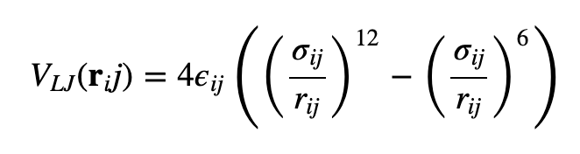
Building a .itp file
The .itp file contains the LJ and bonded forcefield parameters
Non-bonded function type: 1(LJ), 2(Buckingham)
Generate 1-4 parameters
[ defaults ]
; nbfunc comb-rule gen-pairs fudgeLJ fudgeQQ
1 3 yes 0.5 0.5
[ atomtypes ]
; name mass charge ptype sigma eps
C 12.01100 0.000 A 3.54022e-01 2.59188e-01
H 1.00800 0.000 A 2.26000e-01 1.50473e-01
N 14.00670 0.000 A 3.07324e-01 4.20972e-01
LJ combination rule
Scaling factor for 1-4 interactions; for OPLS 0.5
Particle type:
A means atom
S means shell (for polarizable forcefield)
V means virtual side
Notes:
First, I’d like to briefly introduce myself. I’m Kun-Han Lin, I got my PhD at EPFL Switzerland in last September and my advisor was Clemence Corminboeuf.
And I joined Denis’group as a postdoc in last October. My research interest lies in multi-scale simulations and organic semiconductors, especially the charge and energy transport phenomenon in these materials. My main project is to find stable and blue TADF emitters and I also involve in several side projects related to organic semiconductors.

Slide 27
Building a .itp file
The .itp file contains the LJ and bonded forcefield parameters
[ bondtypes ]
C C 1 0.1400 392459.2
C CZ 1 0.1400 322168.0
C H 1 0.1080 307105.6
C C 1 0.1400 392459.2
[ angletypes ]
C C CZ 1 120.00 527.000
C CZ C 1 120.00 527.000
CZ C CZ 1 120.00 527.000
C CZ N 1 120.00 480.000
[ dihedraltypes ]
CN N CZ C 3 -2.02243005 0.83345341 -14.63339062 -4.58329901 18.41310004 3.7542472
C C CZ C 2 0.00000 500.0000
C CZ C CZ 2 0.00000 500.0000
CZ C CZ C 2 0.00000 500.0000
Notes:
First, I’d like to briefly introduce myself. I’m Kun-Han Lin, I got my PhD at EPFL Switzerland in last September and my advisor was Clemence Corminboeuf.
And I joined Denis’group as a postdoc in last October. My research interest lies in multi-scale simulations and organic semiconductors, especially the charge and energy transport phenomenon in these materials. My main project is to find stable and blue TADF emitters and I also involve in several side projects related to organic semiconductors.

Slide 28
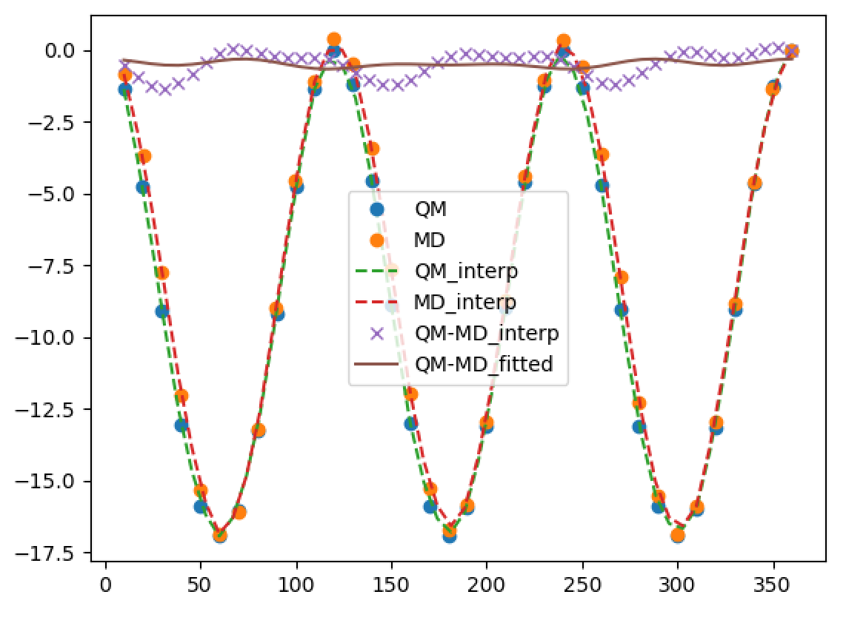
Fitting dihedral angles
Constrained opt at each step (dihedral scanning)
Fit the difference between QM and MM.
Always check the fitting again with updated FF parameters
Check the structure of MM (important!)
Relative energy (kJ/mol)
Dihedral angle
Notes:
First, I’d like to briefly introduce myself. I’m Kun-Han Lin, I got my PhD at EPFL Switzerland in last September and my advisor was Clemence Corminboeuf.
And I joined Denis’group as a postdoc in last October. My research interest lies in multi-scale simulations and organic semiconductors, especially the charge and energy transport phenomenon in these materials. My main project is to find stable and blue TADF emitters and I also involve in several side projects related to organic semiconductors.

Slide 29
Hands-on: construct the itp file (bonded part)
BFL.rtp
BFR.rtp
Make sure that all different types are defined
Check OPLS database (LigParGen) or MATERIALS LIBRARY (in our group)
Check bond length and angle, do you need more atom types?
Potentials of dihedrals connecting two rigid fragments need to be fitted. (dihedral.py) But this can be done only after we specify all nonbonded parameters!
TRZ.rtp
BEN.rtp
CBZ.rtp
1CzTrz
TBU.rtp
Notes:
First, I’d like to briefly introduce myself. I’m Kun-Han Lin, I got my PhD at EPFL Switzerland in last September and my advisor was Clemence Corminboeuf.
And I joined Denis’group as a postdoc in last October. My research interest lies in multi-scale simulations and organic semiconductors, especially the charge and energy transport phenomenon in these materials. My main project is to find stable and blue TADF emitters and I also involve in several side projects related to organic semiconductors.

Slide 30
How to derive atomic charges?
Atomic charges are not experimental observables → not unique!
Different philosophies exist:
Population analysis of WF: Mulliken, Löwdin, CM1, CM2,… charge models
Partitioning of electron density: Bader, Hirshfeld, DDEC,…
Charges derived from electrostatic potential: ChelpG, Merz-Kollman (MK), RESP,…
Charges derived from dipole-dependent properties: dipole charges, atomic polar tensor derived charges (Born effective charge)
Charges from spectroscopy: IR, X-ray, UV-vis, NMR,…
Charges from other exp. data
Notes:
First, I’d like to briefly introduce myself. I’m Kun-Han Lin, I got my PhD at EPFL Switzerland in last September and my advisor was Clemence Corminboeuf.
And I joined Denis’group as a postdoc in last October. My research interest lies in multi-scale simulations and organic semiconductors, especially the charge and energy transport phenomenon in these materials. My main project is to find stable and blue TADF emitters and I also involve in several side projects related to organic semiconductors.

Slide 31
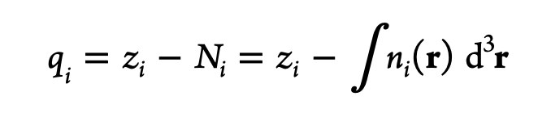
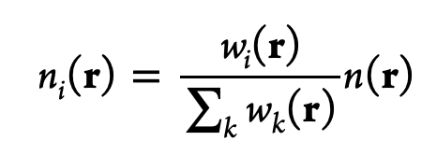
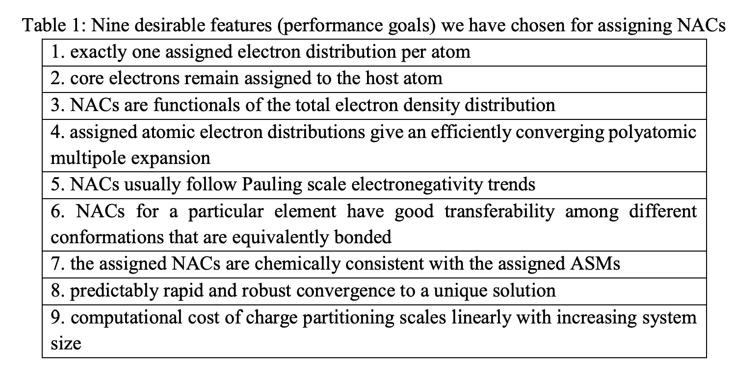
Density derived electrostatic and chemical (DDEC) charges
Atoms-in-molecules (AIM) approach
Partition total electron density into atom basis
Notes:
First, I’d like to briefly introduce myself. I’m Kun-Han Lin, I got my PhD at EPFL Switzerland in last September and my advisor was Clemence Corminboeuf.
And I joined Denis’group as a postdoc in last October. My research interest lies in multi-scale simulations and organic semiconductors, especially the charge and energy transport phenomenon in these materials. My main project is to find stable and blue TADF emitters and I also involve in several side projects related to organic semiconductors.

Slide 32
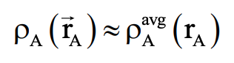
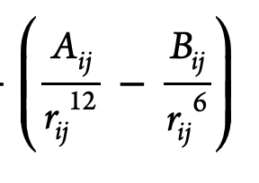
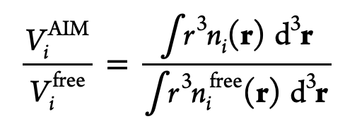
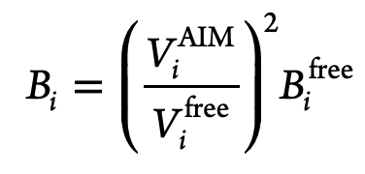
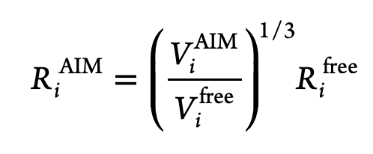
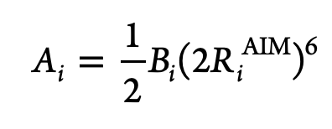
Advantages of DDEC6 charges
Produce reasonable electrostatic potential.
Does not suffer from ill-sampled grid points for large compounds.
AIM partitioning → used for deriving LJ parameters
Notes:
First, I’d like to briefly introduce myself. I’m Kun-Han Lin, I got my PhD at EPFL Switzerland in last September and my advisor was Clemence Corminboeuf.
And I joined Denis’group as a postdoc in last October. My research interest lies in multi-scale simulations and organic semiconductors, especially the charge and energy transport phenomenon in these materials. My main project is to find stable and blue TADF emitters and I also involve in several side projects related to organic semiconductors.

Slide 33
Hands-on: obtain DDEC6 partial charge and LJ parameters
BFL.rtp
BFR.rtp
Perform GAUSSIAN computations (get .wfx)
Execute Chargemol (DDEC computations) https://www.macinchem.org/blog/files/12e725b7408dfa6246bd03ddec0b711f-1515.php
Assign atomic partial charge DDEC6_even_tempered_net_atomic_charges.xyz
Calculate LJ parameters using gen_VDW.py
TRZ.rtp
BEN.rtp
CBZ.rtp
1CzTrz
TBU.rtp
Notes:
First, I’d like to briefly introduce myself. I’m Kun-Han Lin, I got my PhD at EPFL Switzerland in last September and my advisor was Clemence Corminboeuf.
And I joined Denis’group as a postdoc in last October. My research interest lies in multi-scale simulations and organic semiconductors, especially the charge and energy transport phenomenon in these materials. My main project is to find stable and blue TADF emitters and I also involve in several side projects related to organic semiconductors.

Slide 34
Hands-on: how to define soft dihedrals
PMD.rtp
[ defaults ]
; nbfunc comb-rule gen-pairs fudgeLJ fudgeQQ
1 3 yes 0.5 0.5
[ atomtypes ]
; name mass charge ptype sigma eps
C 12.01100 0.000 A 3.54022e-01 2.59188e-01
H 1.00800 0.000 A 2.26000e-01 1.50473e-01
N 14.00670 0.000 A 3.07324e-01 4.20972e-01
CZ 12.01100 0.000 A 3.54022e-01 2.59188e-01
CNZ 12.01100 0.000 A 3.54022e-01 2.59188e-01
CN 12.01100 0.000 A 3.54022e-01 2.59188e-01
C3
CN2
CN4
N1
CNZ
N5
CZ
C5
C1
C4
C2
C3
BEN.rtp
Notes:
First, I’d like to briefly introduce myself. I’m Kun-Han Lin, I got my PhD at EPFL Switzerland in last September and my advisor was Clemence Corminboeuf.
And I joined Denis’group as a postdoc in last October. My research interest lies in multi-scale simulations and organic semiconductors, especially the charge and energy transport phenomenon in these materials. My main project is to find stable and blue TADF emitters and I also involve in several side projects related to organic semiconductors.

Slide 35
Hands-on: how to define soft dihedrals
[ bondtypes ]
; BEN
C C 1 0.1400 392459.2
C CZ 1 0.1400 322168.0
C H 1 0.1080 307105.6
; BEN-PMD
CZ CNZ 1 0.1400 392459.2
;…
[ angletypes ]
; BEN
C C CZ 1 120.00 527.000
C CZ C 1 120.00 527.000
C C C 1 120.00 527.000
C C H 1 120.00 527.000
CZ C H 1 120.00 527.000
; BEN-PMD
C CZ CZN 1 120.00 480.000
[ dihedraltypes ]
C CZ CZN N 3 0.0 0.0 0.0 0.0 0.0 0.0
…
PMD.rtp
C3
CN2
CN4
N1
CNZ
N5
CZ
C5
C1
C4
C2
C3
BEN.rtp
Notes:
First, I’d like to briefly introduce myself. I’m Kun-Han Lin, I got my PhD at EPFL Switzerland in last September and my advisor was Clemence Corminboeuf.
And I joined Denis’group as a postdoc in last October. My research interest lies in multi-scale simulations and organic semiconductors, especially the charge and energy transport phenomenon in these materials. My main project is to find stable and blue TADF emitters and I also involve in several side projects related to organic semiconductors.

Slide 36
How to evaluate the quality of FF parameters?
Check if it predicts the property of interest (if exp. value is available).
Compare the distribution of internal coordinate in NVT simulations (FF vs QM or semiempirical).
Compare vibrational frequencies (FF vs QM or semiempirical).
Compare the relative energies using the MD trajectory.
Compare the bulk properties with exp. results. (density, radial distribution function, glass-transition temperature, melting point, … )
Notes:
First, I’d like to briefly introduce myself. I’m Kun-Han Lin, I got my PhD at EPFL Switzerland in last September and my advisor was Clemence Corminboeuf.
And I joined Denis’group as a postdoc in last October. My research interest lies in multi-scale simulations and organic semiconductors, especially the charge and energy transport phenomenon in these materials. My main project is to find stable and blue TADF emitters and I also involve in several side projects related to organic semiconductors.

Slide 37
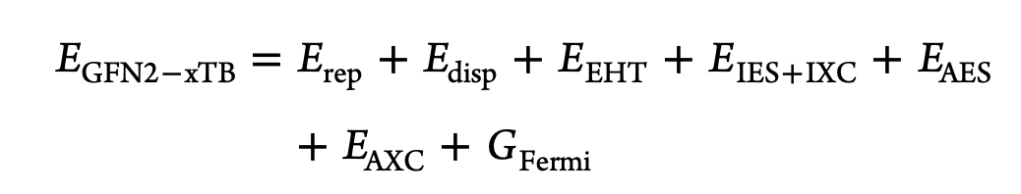
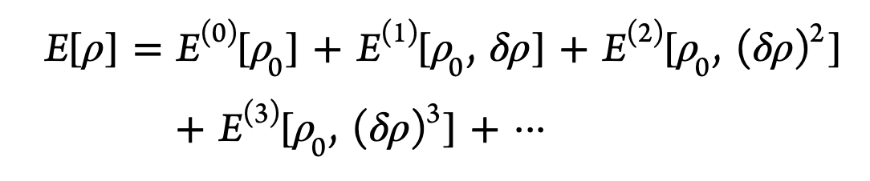
GFN2-xTB
Similar to DFTB3, where the Kohn−Sham DFT energy is expanded (up to 3rd order) in terms of density fluctuations δρ relative to a superposition of atomic reference densities.
Main difference: pair-specific vs element-specific parameters
J. Chem. Theory Comput. 2019, 15, 1652−1671
Notes:
First, I’d like to briefly introduce myself. I’m Kun-Han Lin, I got my PhD at EPFL Switzerland in last September and my advisor was Clemence Corminboeuf.
And I joined Denis’group as a postdoc in last October. My research interest lies in multi-scale simulations and organic semiconductors, especially the charge and energy transport phenomenon in these materials. My main project is to find stable and blue TADF emitters and I also involve in several side projects related to organic semiconductors.

Slide 38
GROMACS mdp files
integrator = cg
; Section for energy minimization
emtol = 1.0
emstep = 0.01
nsteps = 200000
energygrps = system
; Neighbor searching
nstlist = 10
ns_type = grid
rlist = 1.2
cutoff-scheme = Verlet
vdwtype = cut-off
coulombtype = PME
rcoulomb = 1.2
rvdw = 1.2
pbc = xyz
DispCorr = EnerPres
; Output setting
nstxout = 1000
nstvout = 1000
nstfout = 1000
nstlog = 5000
nstenergy = 1000
conjugated gradient method
convergence criteria (force [kJ/mol/nm])
step-size
number of steps
groups to write short-ranged non-bonded potential energies to edr files
[steps] frequency to update neighbor list
make grids in the box and check atoms in neighboring grid cells
cutoff distance for short-range neighbor list
Verlet list
Fast smooth particle-mesh Ewald electrostatic.
Coulomb cutoff
LJ cutoff
Apply long range dispersion corrections for Energy and Pressure
J. Chem. Theory Comput. 2019, 15, 1652−1671
Notes:
First, I’d like to briefly introduce myself. I’m Kun-Han Lin, I got my PhD at EPFL Switzerland in last September and my advisor was Clemence Corminboeuf.
And I joined Denis’group as a postdoc in last October. My research interest lies in multi-scale simulations and organic semiconductors, especially the charge and energy transport phenomenon in these materials. My main project is to find stable and blue TADF emitters and I also involve in several side projects related to organic semiconductors.

Slide 39
Cell lists
O(N²) vs O(Nc)
https://en.wikipedia.org/wiki/Cell_lists
Notes:
First, I’d like to briefly introduce myself. I’m Kun-Han Lin, I got my PhD at EPFL Switzerland in last September and my advisor was Clemence Corminboeuf.
And I joined Denis’group as a postdoc in last October. My research interest lies in multi-scale simulations and organic semiconductors, especially the charge and energy transport phenomenon in these materials. My main project is to find stable and blue TADF emitters and I also involve in several side projects related to organic semiconductors.

Slide 40
GFN2-xTB input
$md
temp=300 # in K
time=500.0 # in ps
dump= 50.0 # in fs
step= 1.0 # in fs
velo=false
nvt =true
hmass=4
shake=2
sccacc=2.0
$end
Temperature
Simulation time
Save a coordinate every 50.0 fs
Integration time step
Write out velocity
NVT or NVE
Mass of H atoms
Use SHAKE algorithm (2 = all bonds)
Accuracy of xTB calculation in dynamics
Notes:
First, I’d like to briefly introduce myself. I’m Kun-Han Lin, I got my PhD at EPFL Switzerland in last September and my advisor was Clemence Corminboeuf.
And I joined Denis’group as a postdoc in last October. My research interest lies in multi-scale simulations and organic semiconductors, especially the charge and energy transport phenomenon in these materials. My main project is to find stable and blue TADF emitters and I also involve in several side projects related to organic semiconductors.

Slide 41
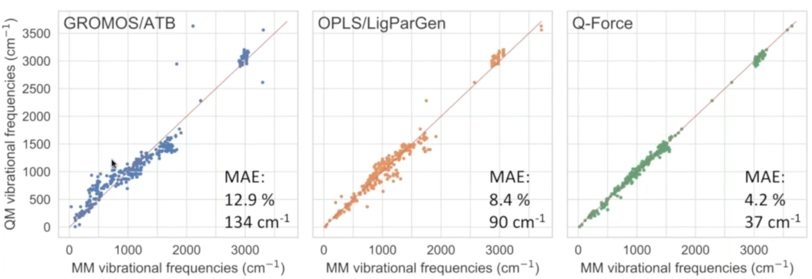
Compare vibrational frequencies
Webinar 53 - Q-Force-Automated Parametrization of QM-Based Force Fields Using Q-Chem
Notes:
First, I’d like to briefly introduce myself. I’m Kun-Han Lin, I got my PhD at EPFL Switzerland in last September and my advisor was Clemence Corminboeuf.
And I joined Denis’group as a postdoc in last October. My research interest lies in multi-scale simulations and organic semiconductors, especially the charge and energy transport phenomenon in these materials. My main project is to find stable and blue TADF emitters and I also involve in several side projects related to organic semiconductors.

Slide 42
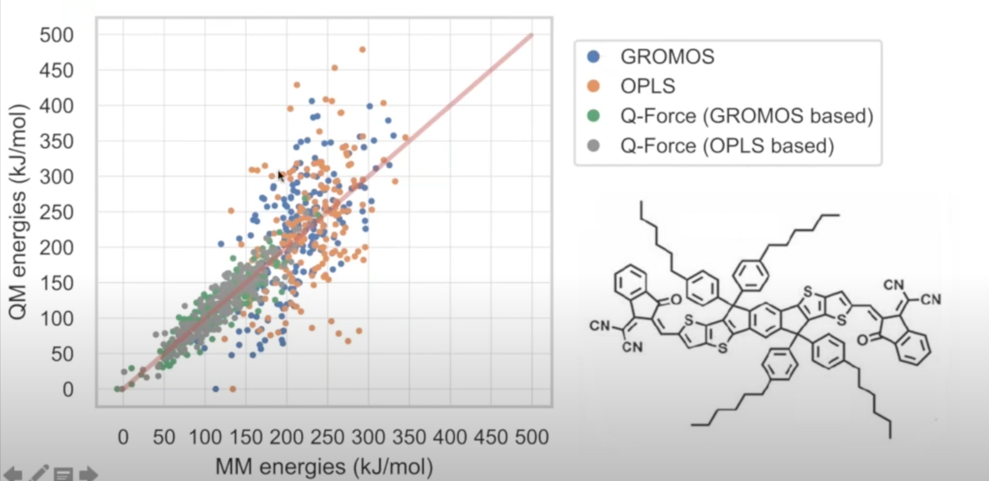
Compare relative energies
Webinar 53 - Q-Force-Automated Parametrization of QM-Based Force Fields Using Q-Chem
Notes:
First, I’d like to briefly introduce myself. I’m Kun-Han Lin, I got my PhD at EPFL Switzerland in last September and my advisor was Clemence Corminboeuf.
And I joined Denis’group as a postdoc in last October. My research interest lies in multi-scale simulations and organic semiconductors, especially the charge and energy transport phenomenon in these materials. My main project is to find stable and blue TADF emitters and I also involve in several side projects related to organic semiconductors.

Slide 43
Hands-on: evaluate the FF parameters
Copy the directory to your folder: /data/bee14/link/work/4_Naomi/EVALUATE_FF
QM_GAS_PHASE/NM: Normal mode analysis using DFT
MD_SINGLE/FF: MD simulations and NM analysis using force field
MD_SINGLE/XTB: MD simulations using GFN2-xTB method
PMD.rtp
C3
CN2
CN4
N1
CNZ
N5
CZ
C5
C1
C4
C2
C3
BEN.rtp
Notes:
First, I’d like to briefly introduce myself. I’m Kun-Han Lin, I got my PhD at EPFL Switzerland in last September and my advisor was Clemence Corminboeuf.
And I joined Denis’group as a postdoc in last October. My research interest lies in multi-scale simulations and organic semiconductors, especially the charge and energy transport phenomenon in these materials. My main project is to find stable and blue TADF emitters and I also involve in several side projects related to organic semiconductors.

